Slide 1
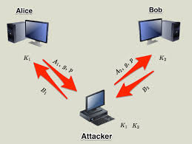
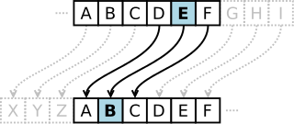
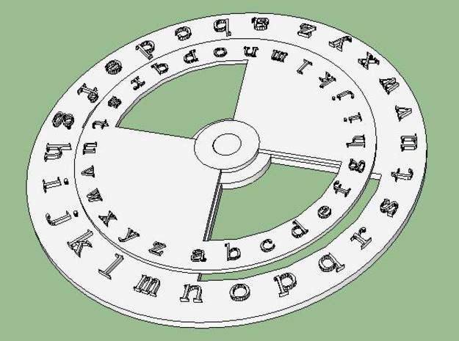
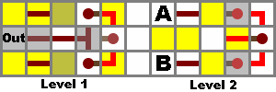
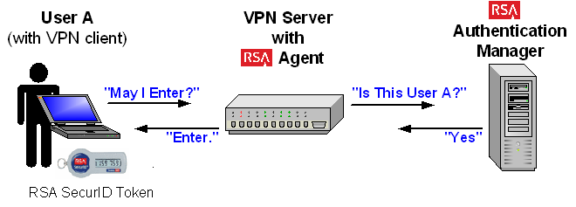
Number Theory and Internet Encryption James Prugh Indian Hill High School, Precalculus
RET is funded by the National Science Foundation, grant # EEC-1404766
What is number theory?
How is my personal
information kept secure?
How is number theory
applied to
internet security?
The Research
The History
Ancient Times
Medievil / Renaissance
20th Century
Modern Times
The Mathematicians
Leonhard Euler
Pierre de Fermat
Euclid of Alexandria
Claude Shannon
The Algorithms
Modular Arithmetic
Babylonian Algorithm
Euclid’s Algorithm
Fermat’s Little Theorem
Coding
convert data to binary
Ciphers
encrypt and protect data
Public and Secret Key
Cryptography
encryption and decryption
Diffie-Hellman Algorithm
use modular arithmetic to create a shared key
XOR Operator
quick inversion with high entropy
RSA
sign a message using two different keys
https://commons.wikimedia.org/wiki/File:Binary_Back.jpg
http://stackoverflow.com/questions/10471009/how-does-the-man-in-the-middle-attack-work-in-diffie-hellman
https://learncryptography.com/classical-encryption/caesar-cipher
http://www.shapeways.com/product/S8Q6FKZ9L/caesar-cipher-decoder-ring
http://www.vlsiinterviewquestions.org/2012/04/17/xor-gate-using-21-mux/
http://www.pagedon.com/rsa-explained-simply/my_programming

